Slide 1
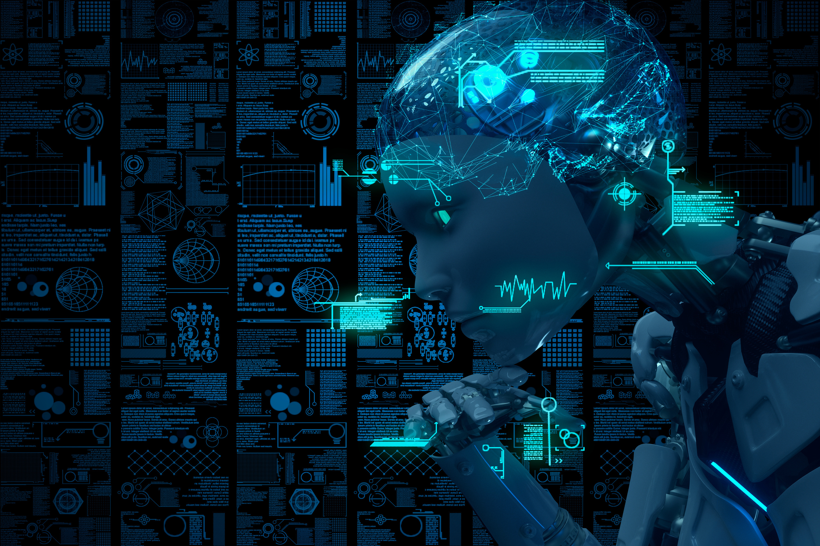

LINGUAGEN
A Comprehensive Natural Language Toolkit
Mentor Name:- Dr. Tanveer Ahmed Candidate Name:- Saurabh Sharma Enrol Number:- E22CSEU0882

Slide 2

INTRODUCTION
Background Information: The rapid advancement of natural language processing (NLP) techniques has opened avenues for innovative applications in text processing.
Problem Statement: Despite the availability of various NLP tools, there is a need for a comprehensive toolkit that integrates text generation, summarization, and speech synthesis functionalities.
Objectives:
Develop a versatile NLP toolkit capable of text generation, summarization, PDF text extraction, and text-to-speech conversion.
Provide a user-friendly interface for seamless interaction with the toolkit.

Slide 3
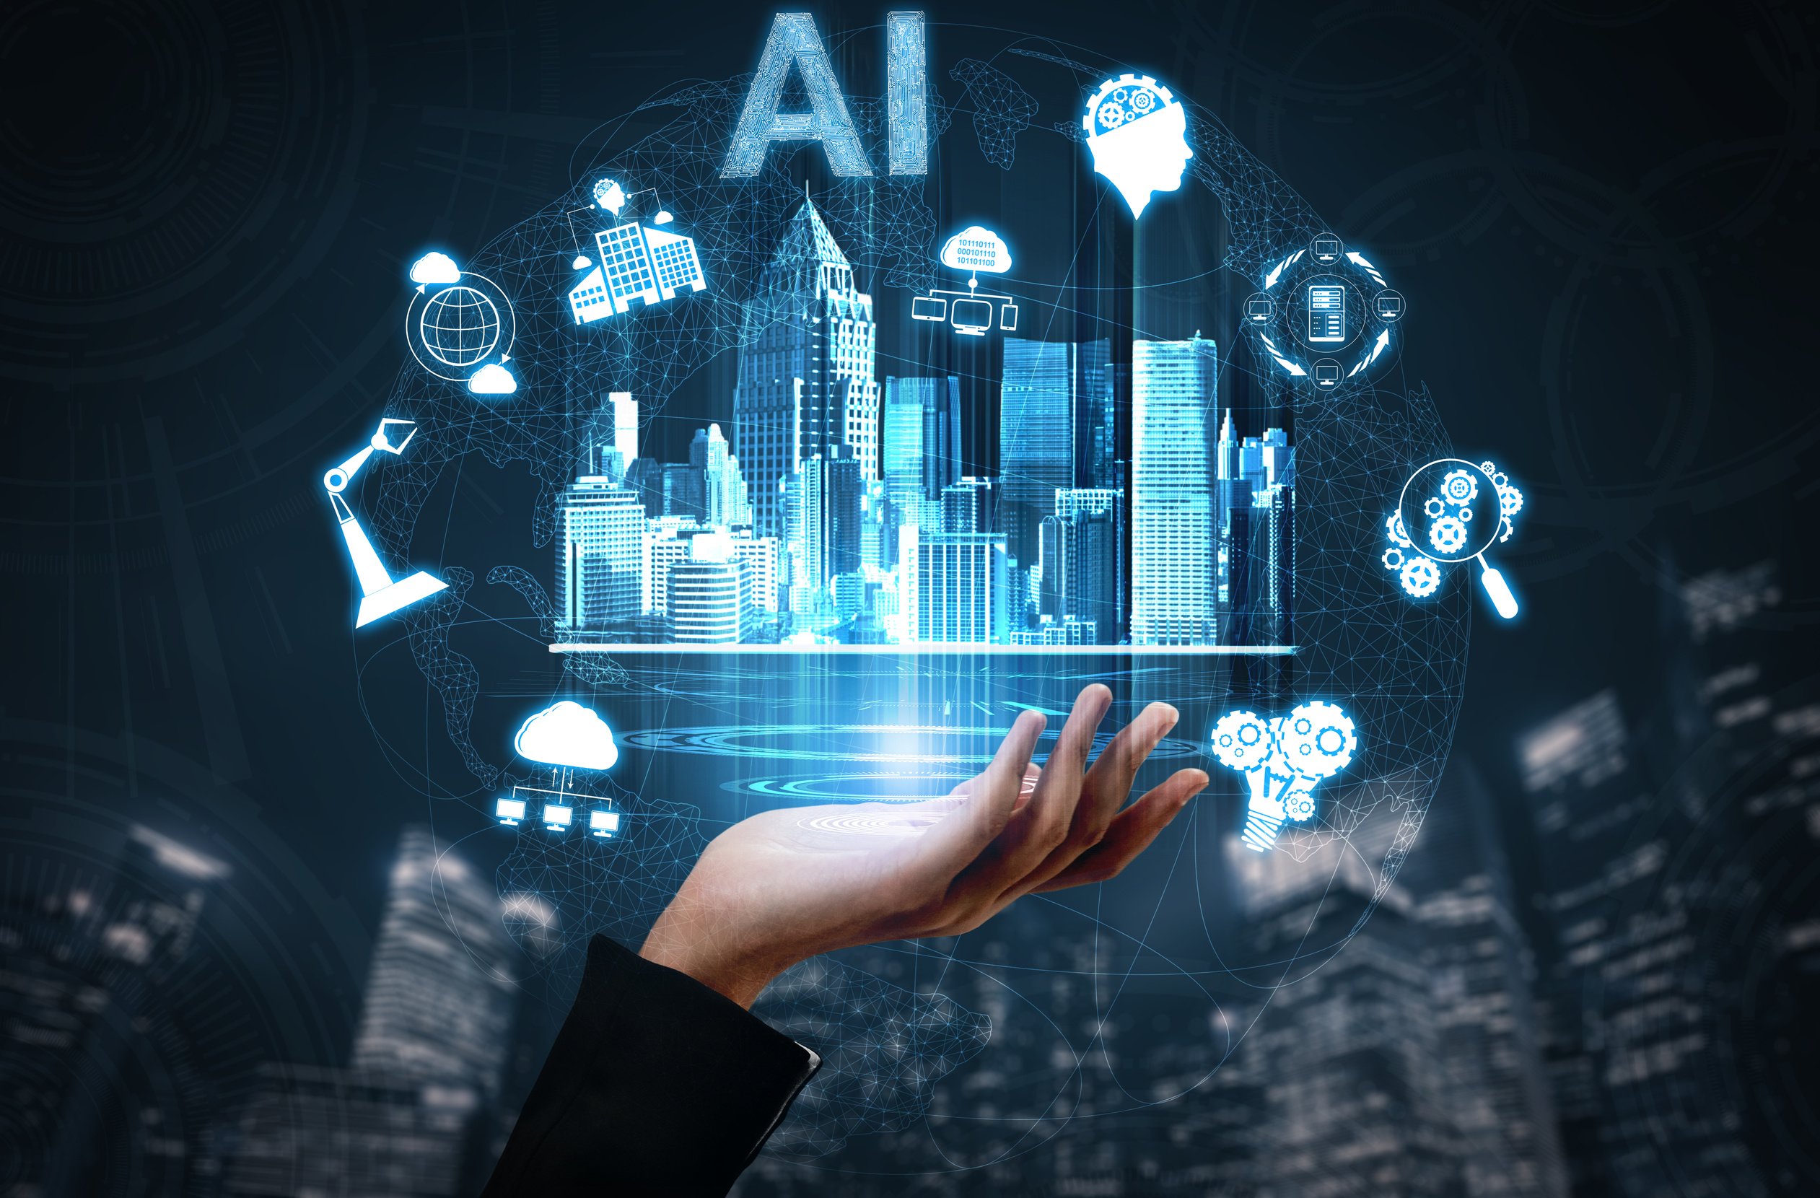
LITERATURE REVIEW
Key Findings: Previous research has demonstrated the effectiveness of transformer-based models like GPT-2 and Llama 2 in text generation tasks. Additionally, advancements in summarization techniques using libraries like Spacy have been noted.
Research Gap: Despite existing solutions, there is a lack of an all-encompassing toolkit that integrates various NLP functionalities seamlessly.

Slide 4
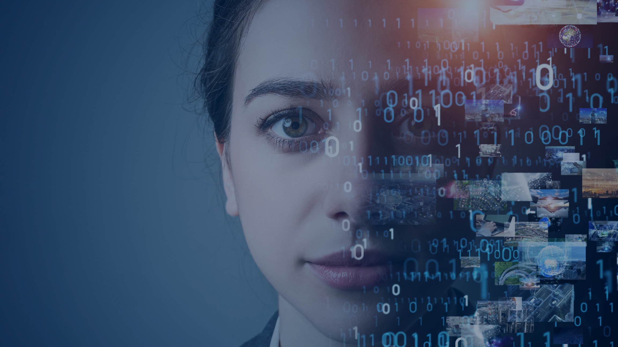
PROJECT SCOPE AND CONSTRAINTS
Scope of the Project: The project focuses on developing a comprehensive NLP toolkit with specific emphasis on text generation, summarization, and speech synthesis.
Constraints: Time constraints and resource limitations may impact the extent of features implemented.

Slide 5

METHODOLOGY
Technologies Used: GPT-2, Llama 2, TensorFlow, Spacy, PyMuPDF, Fitz, Tkinter, gTTS, Playsound.
Development Approach: Agile methodology was adopted for iterative development and continuous integration.
Data Collection/Analysis: Various datasets, including the Shakespeare dataset, were utilized for training and testing the models.

Slide 6

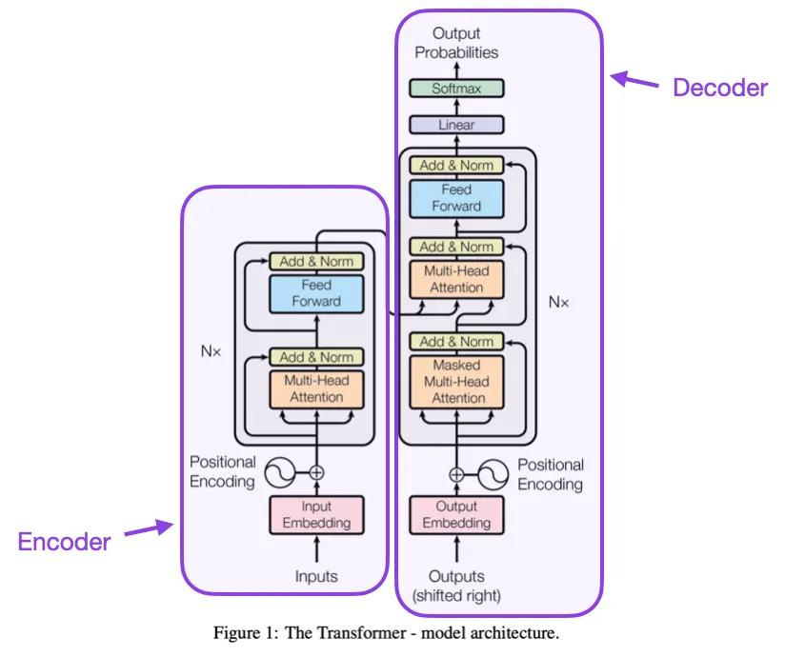
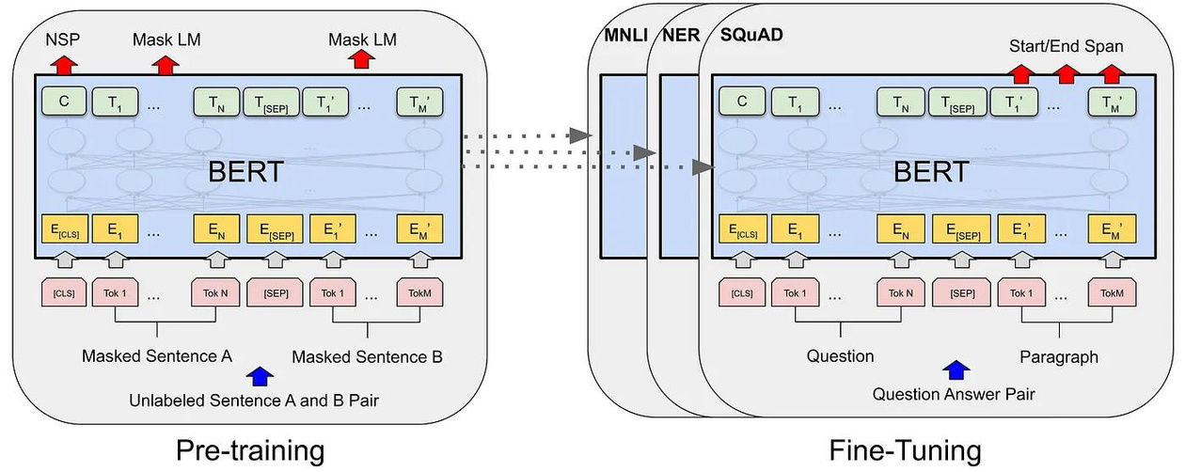
System Design /Architecture
System Components:
Text Generation Module (GPT-2, Llama 2, TensorFlow RNN)
Summarization Module (Spacy)
PDF Text Extraction Module (PyMuPDF, Fitz)
Text-to-Speech Conversion Module (Tkinter, gTTS, Playsound)

Slide 7
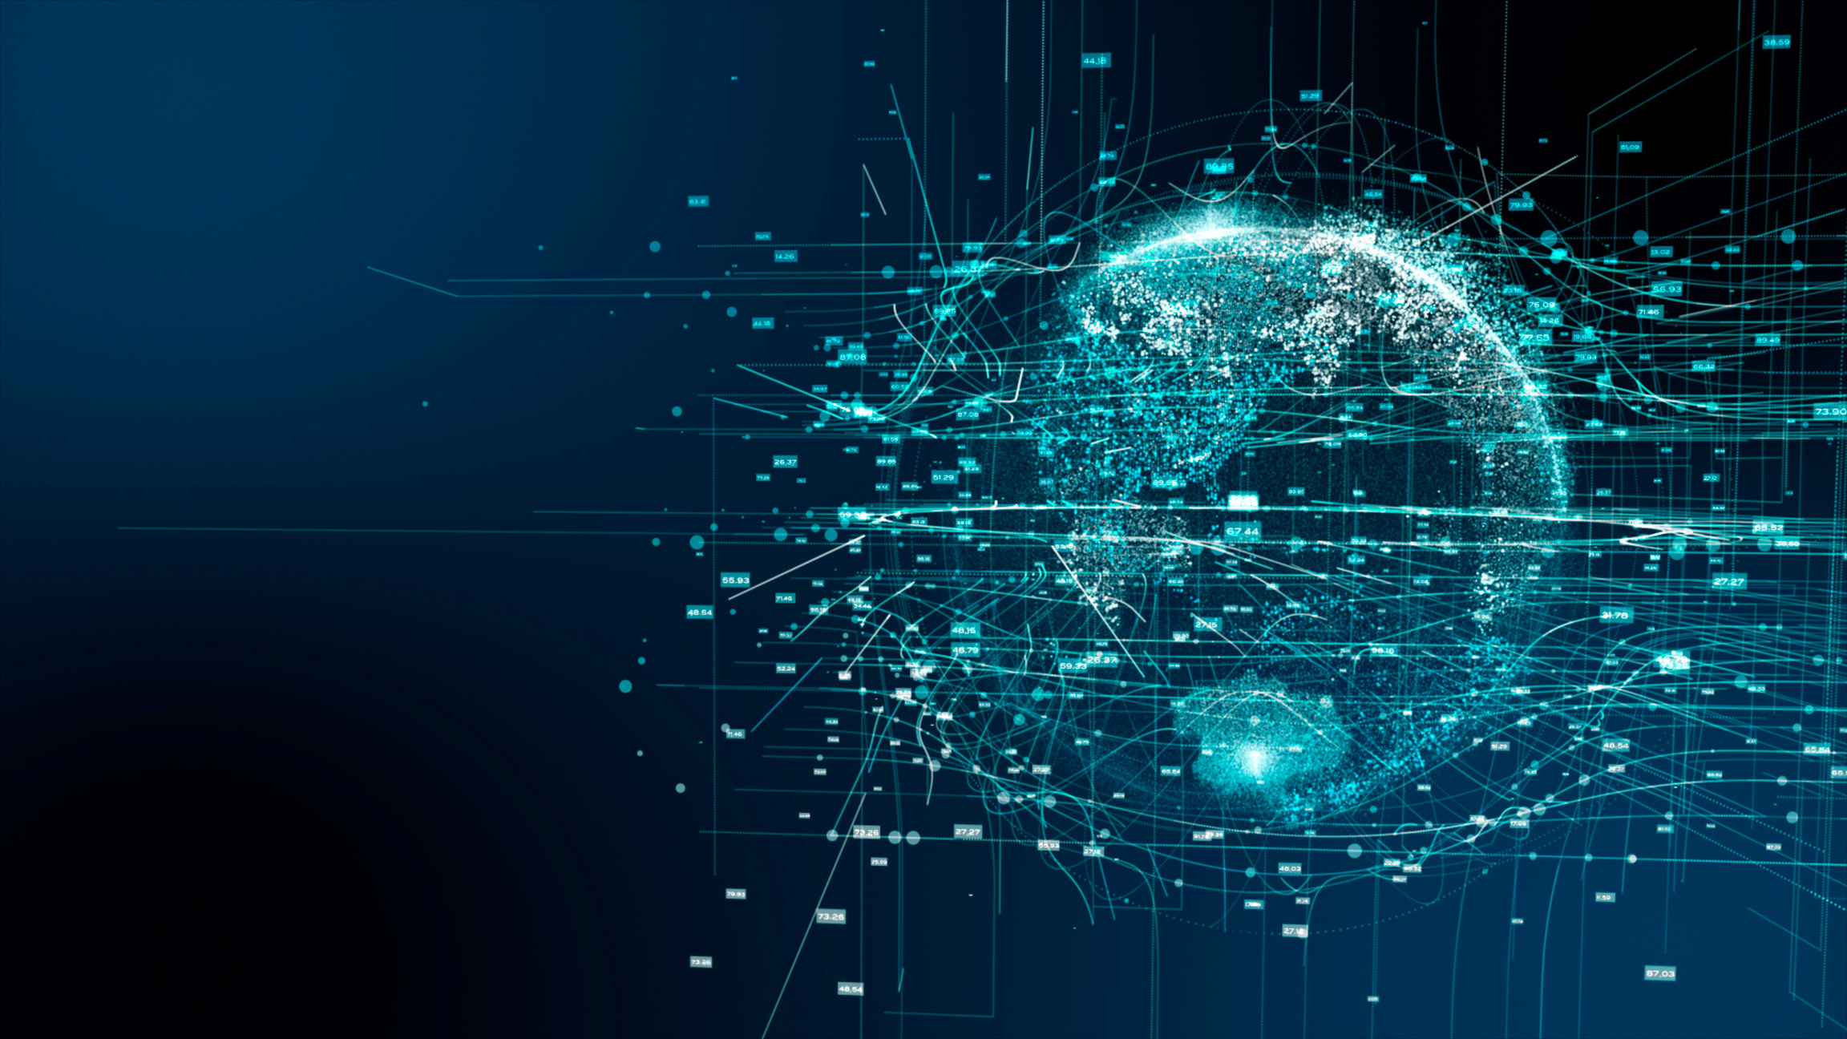
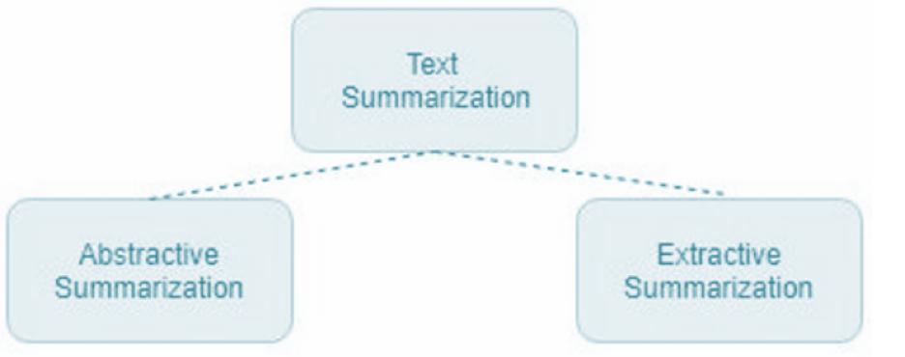
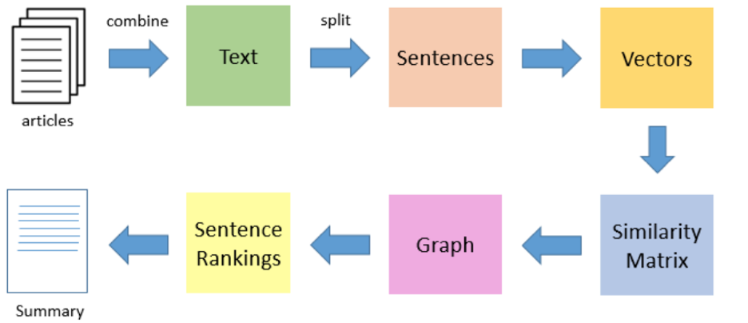

Slide 8

IMPLEMENTATION
Implementation Details:
Integration of GPT-2, Llama 2, and TensorFlow RNN for text generation.
Utilization of Spacy for text summarization.
Implementation of PDF text extraction using PyMuPDF and Fitz.
Development of a GUI for text-to-speech conversion with Tkinter.

Slide 9



IMPACT AND APPLICATIONS
Practical Impact: The NLP toolkit has practical applications in research, education, and industry, facilitating efficient text processing tasks.
User Benefits: Users can benefit from the toolkit's versatility and user-friendly interface, enhancing productivity and workflow efficiency.

Slide 10

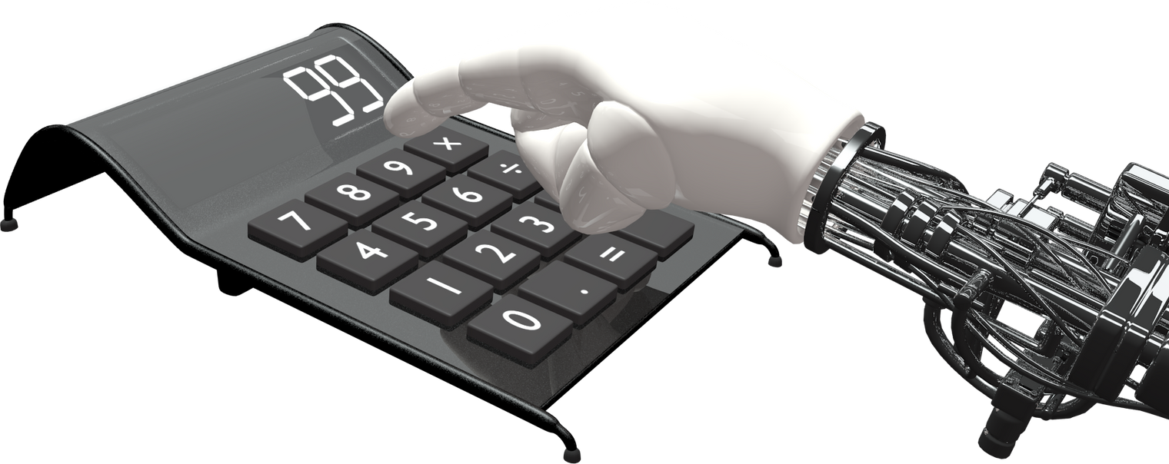

FUTURE WORK
Improvements: Suggestions for enhancing existing functionalities and adding new features.
Scalability: Discuss how the toolkit can be scaled or extended to accommodate future requirements.

Slide 11
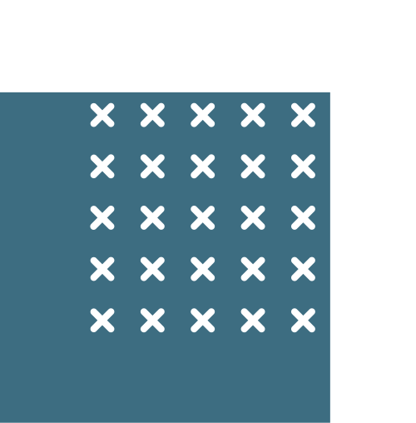
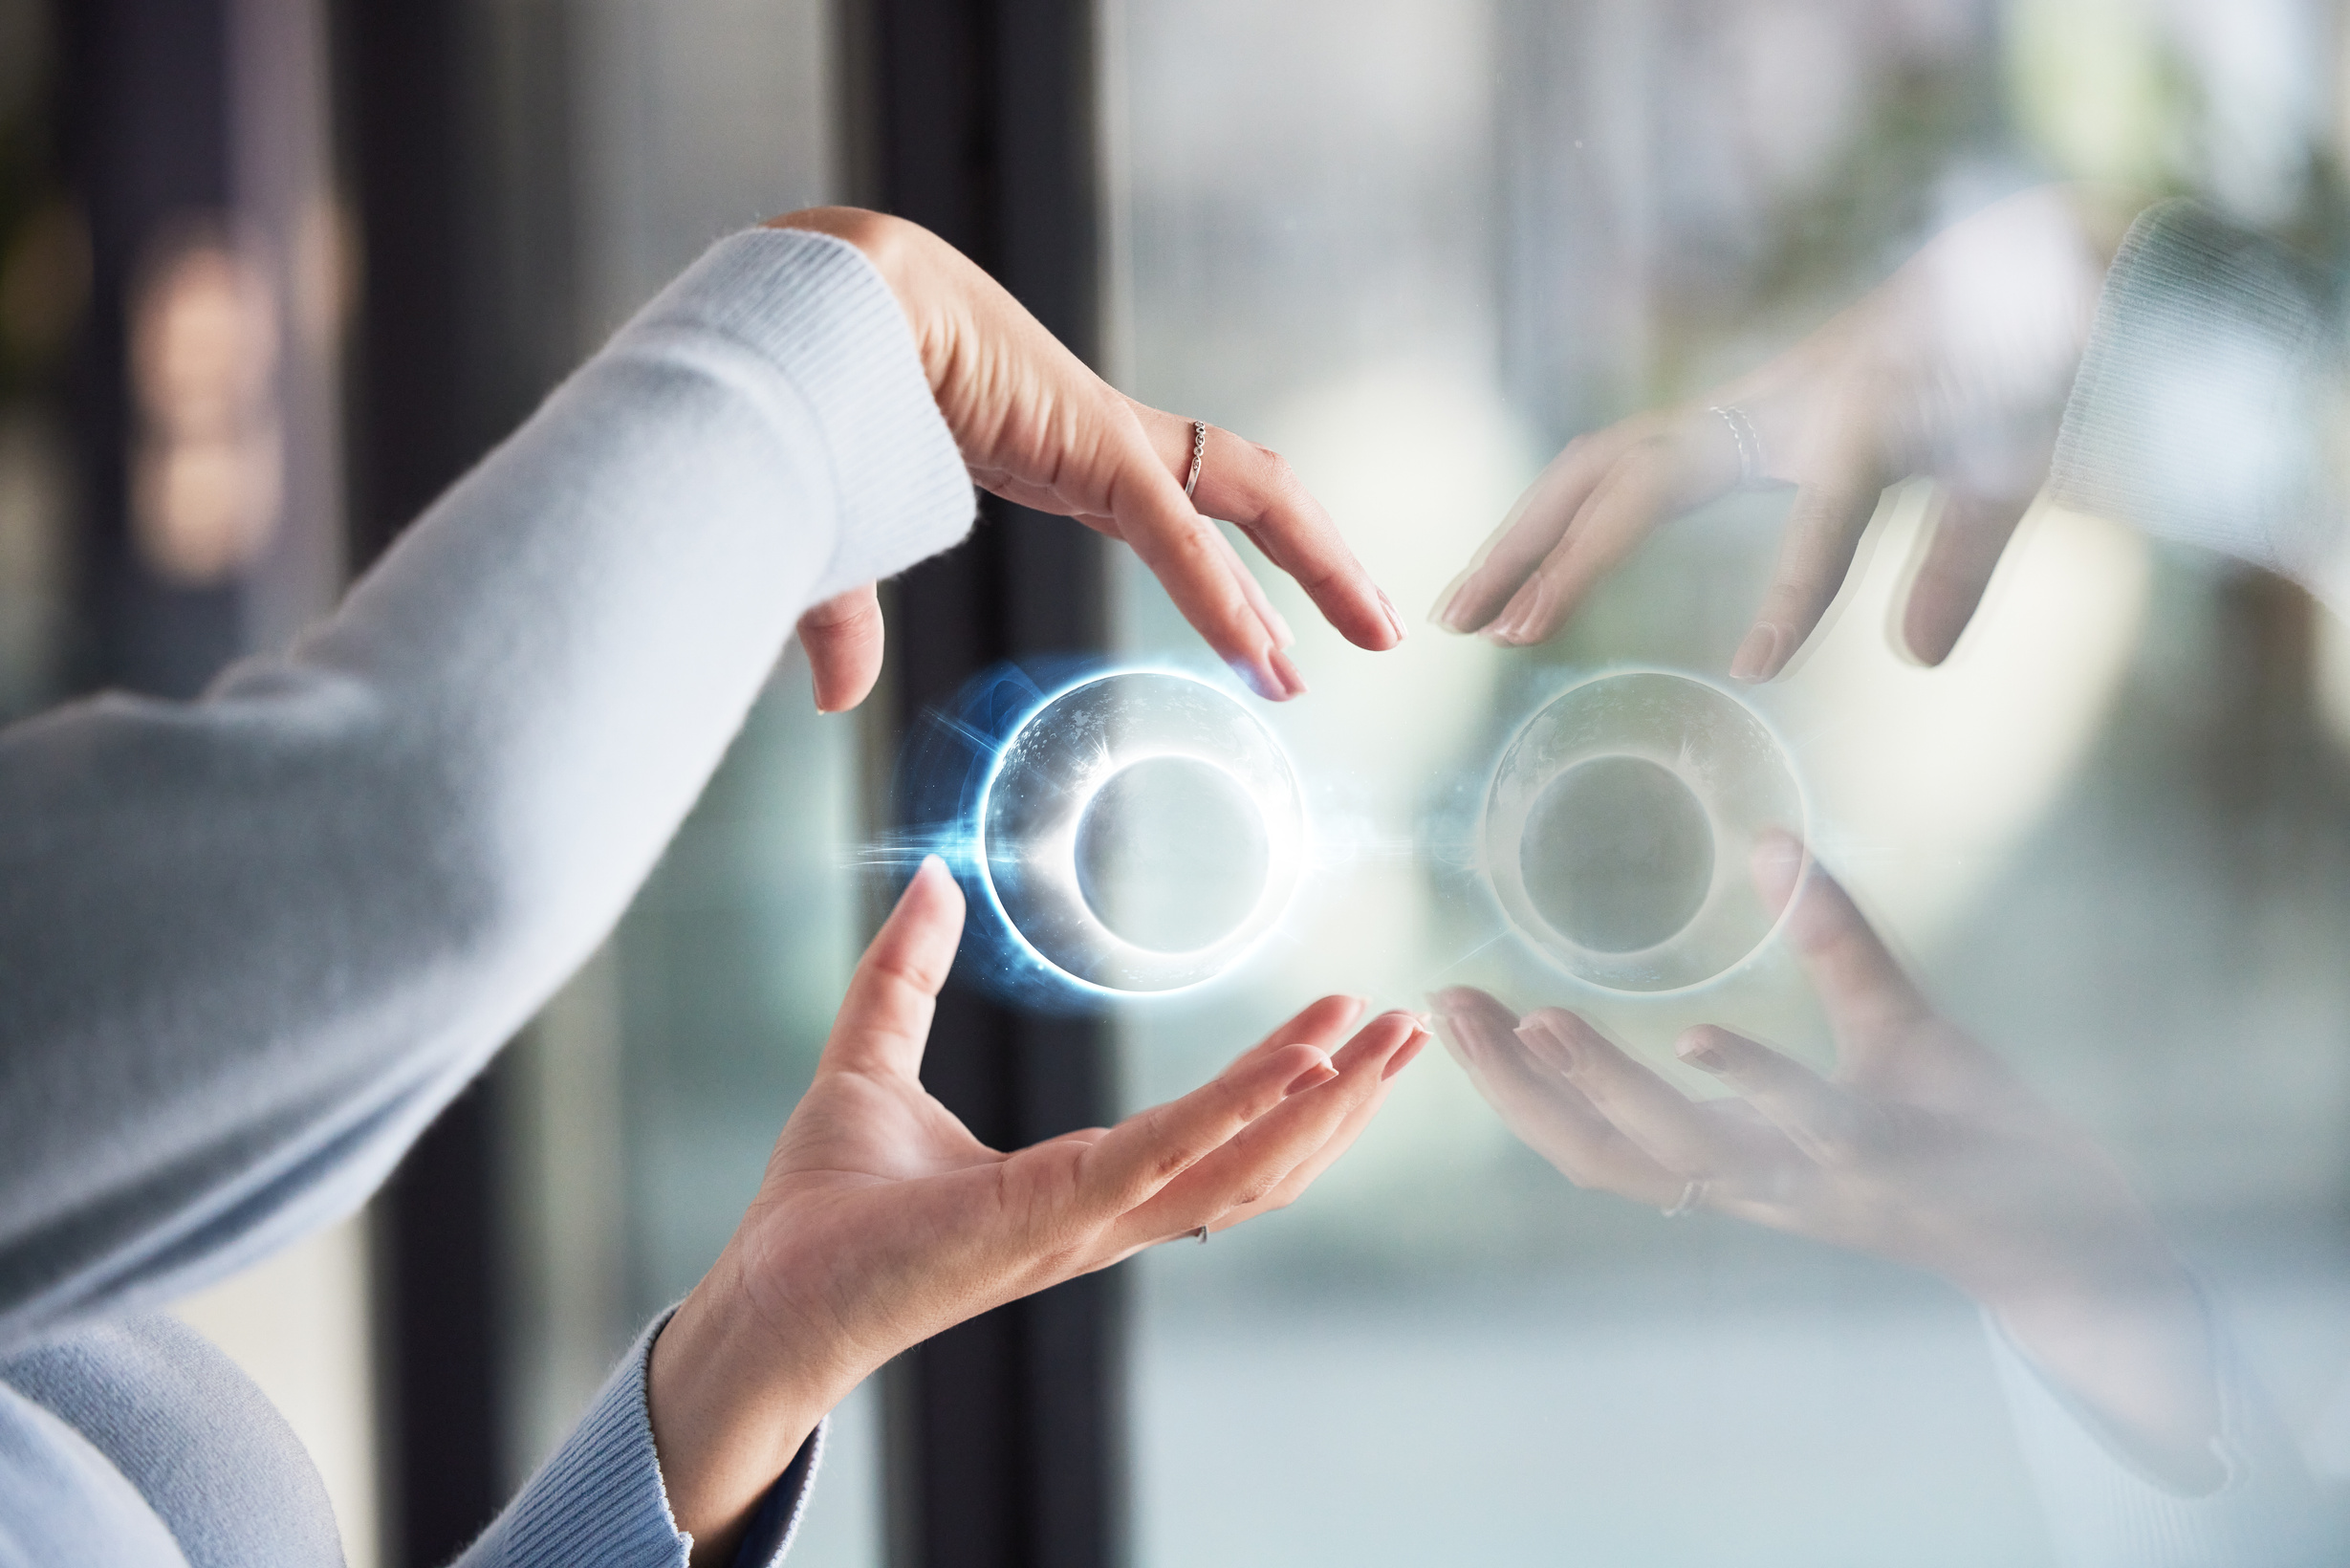
Q&A
ALLOW THE AUDIENCE TO ASK QUESTIONS AND CLARIFY ANY DOUBTS.

Slide 12
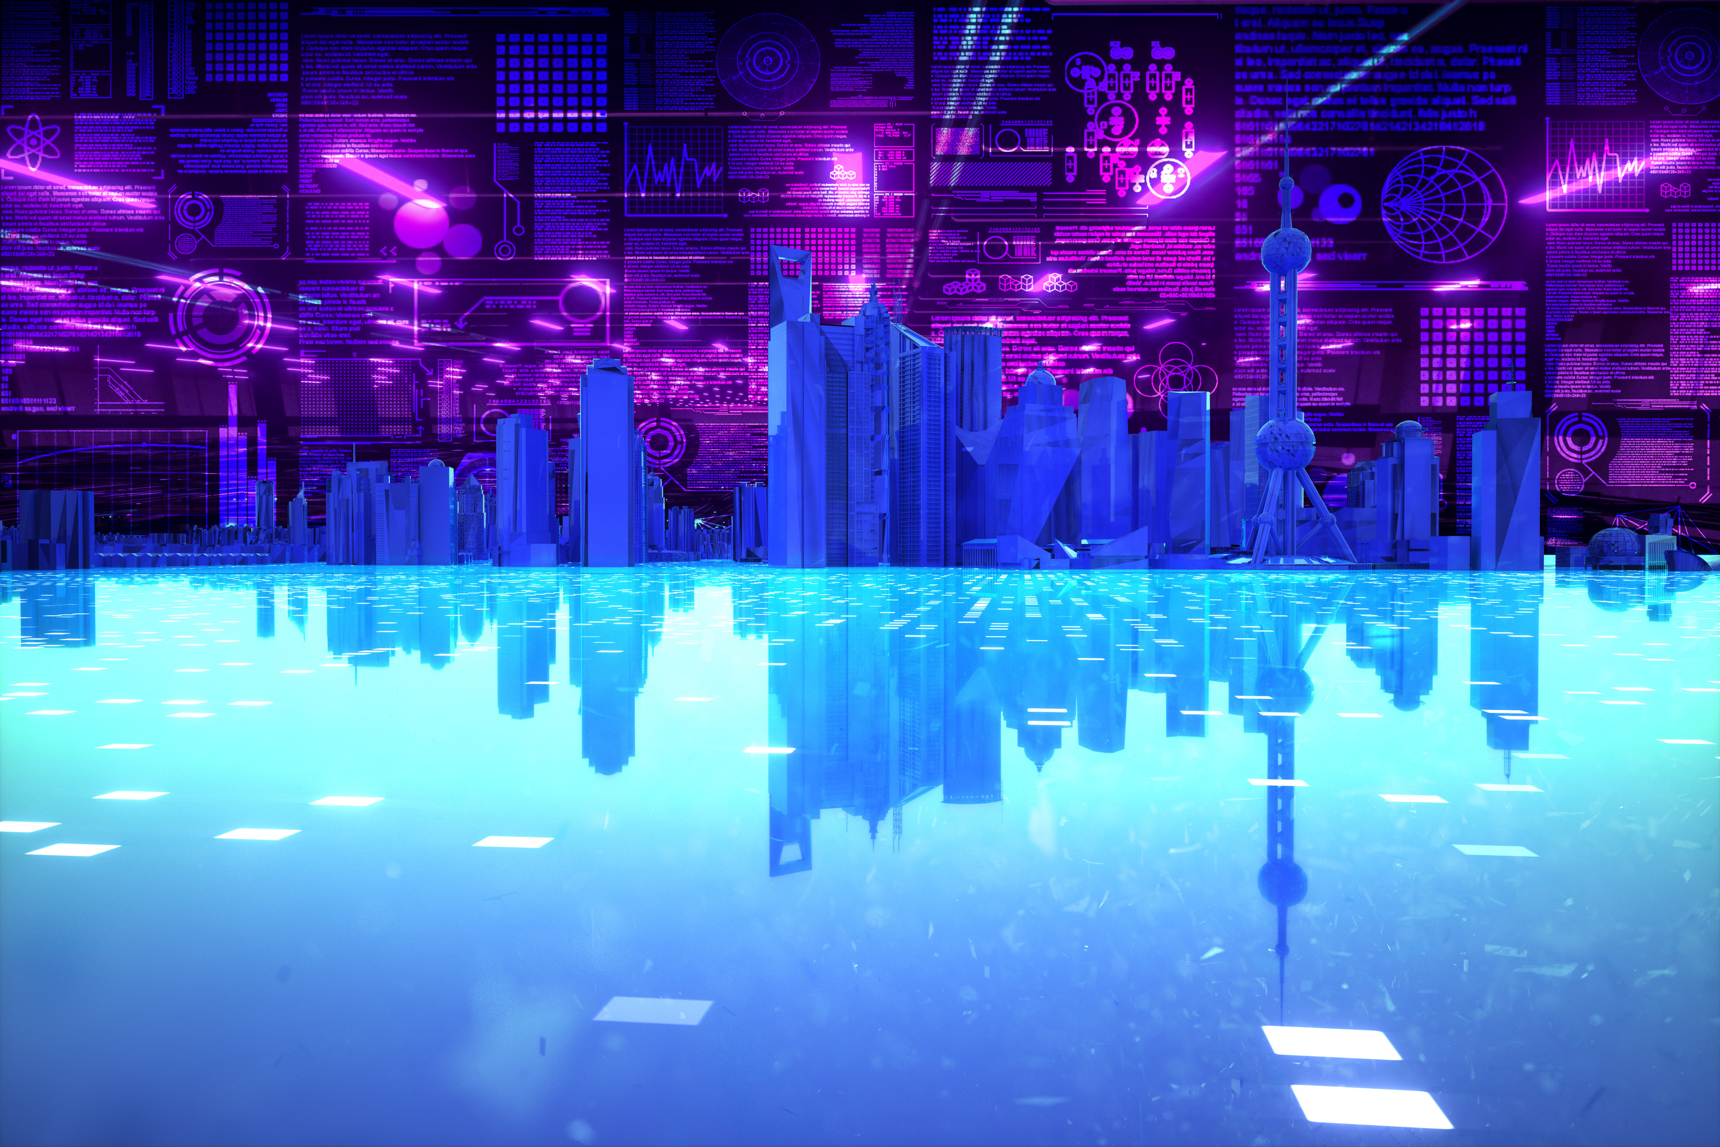
Thank You!

